Slide 1


Facebook
The System
Brenda Nyangweso – Data Flow Diagrams (DFD) & Interaction Diagrams
Rukshar Parwin - Use Case Model & Class Diagrams

Slide 2
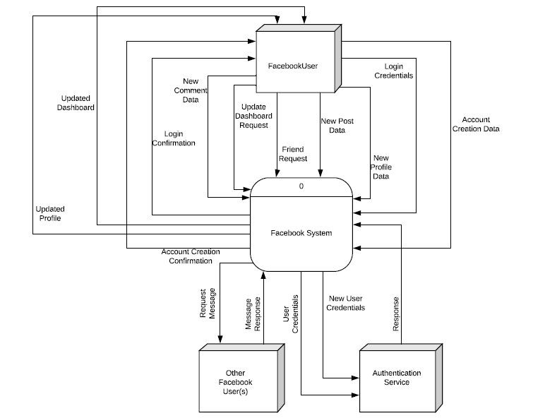
The Context Diagram
Entities:
FacebookUser
Authentication Service
Other Facebook User(s)

Slide 3
Processes & Stores
Processes
Stores
Create Account
Login User
Update Profile
Create Post
Create Comment
Send Friend Request
Update Dashboard
User Data
Posts
Comments
Messages

Slide 4
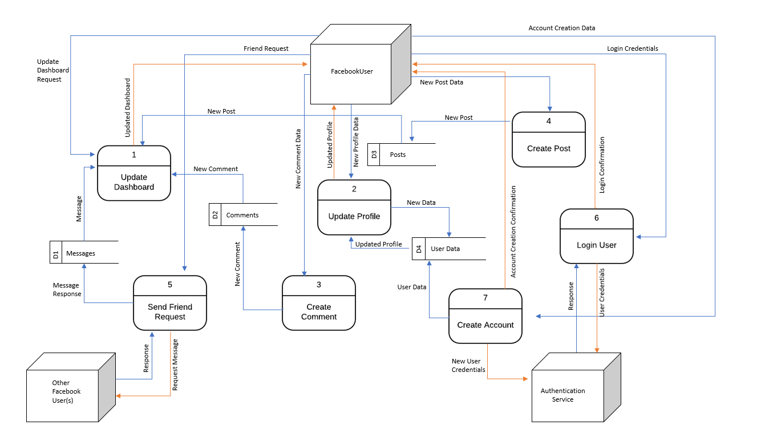
Diagram 0 DFD
Key:
Output to Entities.
Data flow into & within the System.

Slide 5
Interaction Diagrams
# | Sequence Diagram | Actor(s) | Object(s)
1 | Facebook System | FacebookUser, Authentication Service, Other FacebookUser (s) | Facebook System
2 | Create Account | FacebookUser, Authentication Service | Account, User Data
3 | Login User | FacebookUser, Authentication Service | Account
4 | Create Post | FacebookUser | Dashboard, Post
5 | Create Comment | FacebookUser | Dashboard, Comment
6 | Update Profile | FacebookUser | Dashboard, User Data
7 | Update Dashboard | FacebookUser | Dashboard
8 | Send Friend Request | FacebookUser, Other FacebookUser (s) | Dashboard

Slide 6
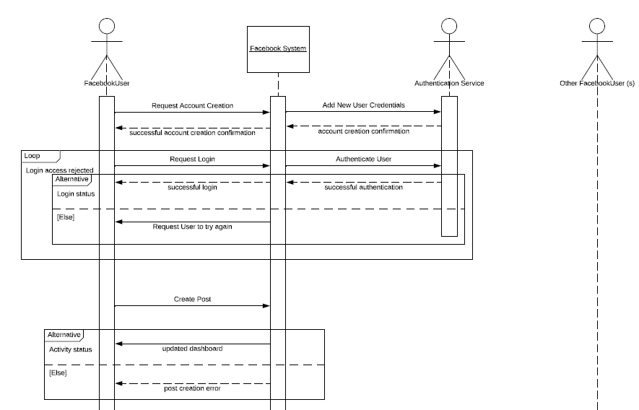
Facebook System Sequence Diagram

Slide 7
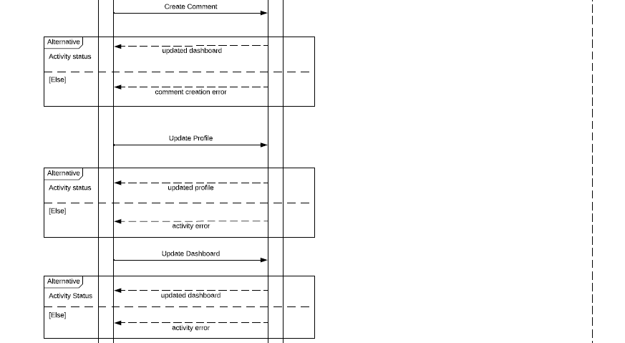
Facebook System Sequence Diagram

Slide 8
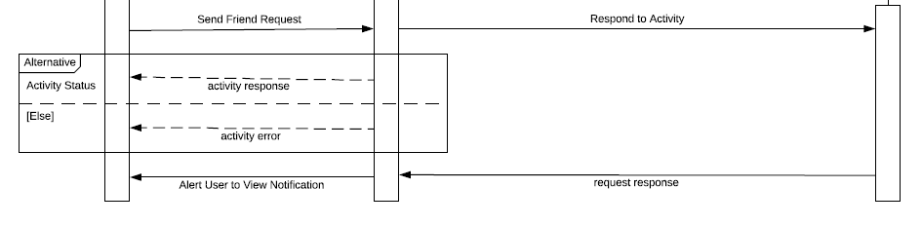
Facebook System Sequence Diagram

Slide 9
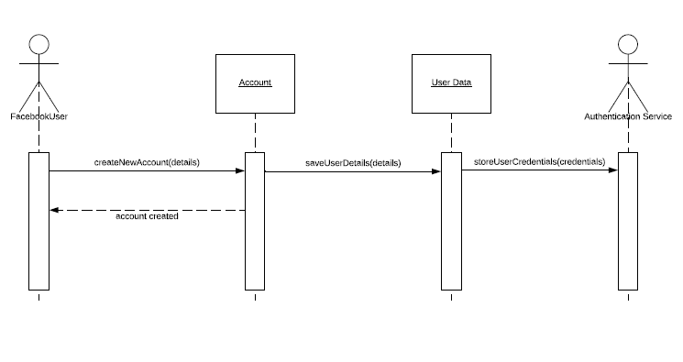
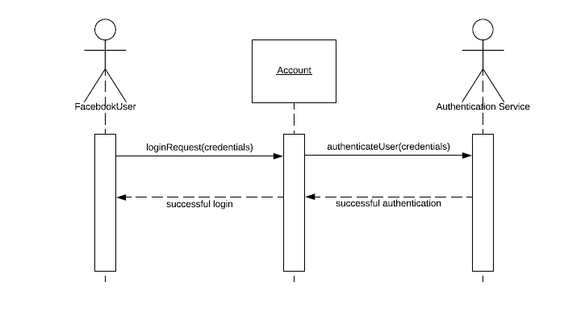
Interaction Diagrams
Create Account Sequence Diagram
Login User Sequence Diagram

Slide 10
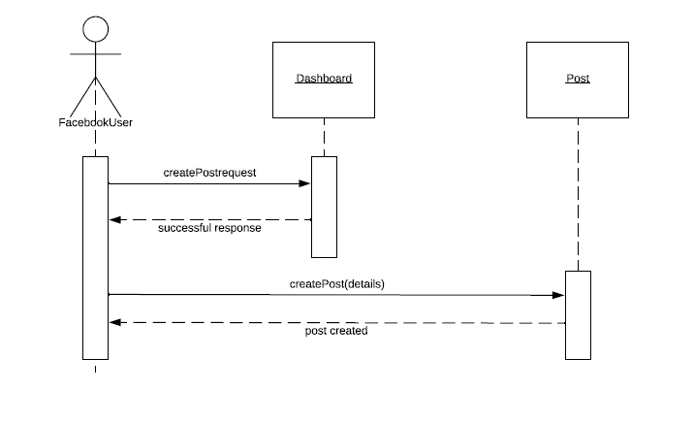
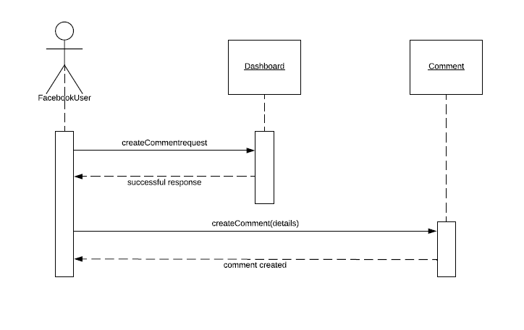
Interaction Diagrams
Create Post Sequence Diagram
Create Comment Sequence Diagram

Slide 11
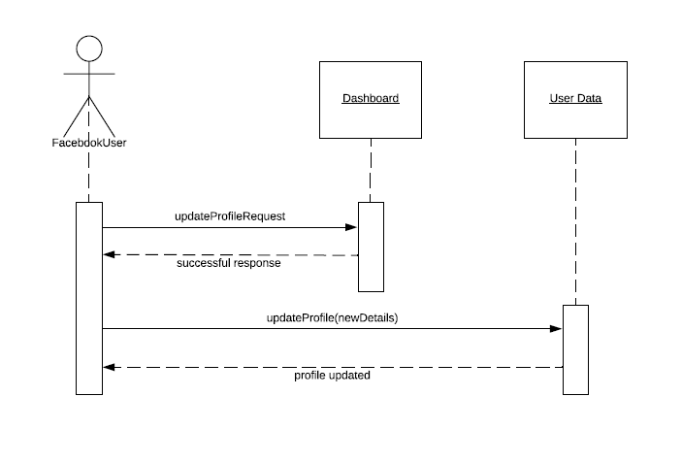
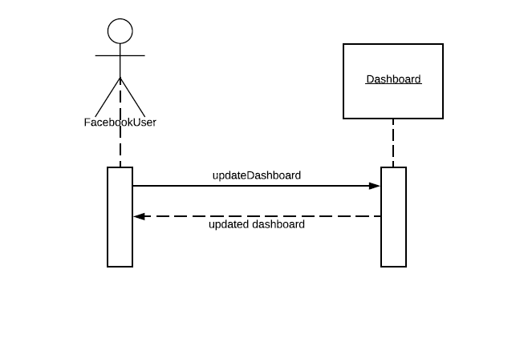
Interaction Diagrams
Update Profile Sequence Diagram
Update Dashboard Sequence Diagram

Slide 12
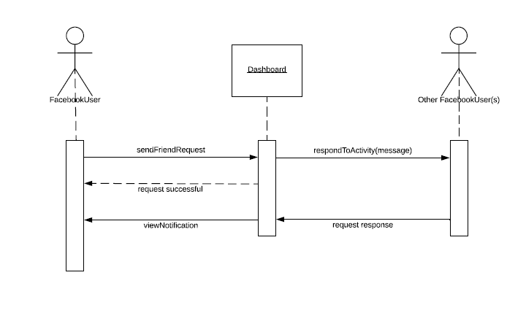
Interaction Diagrams
Send Friend Request Sequence Diagram

Slide 13
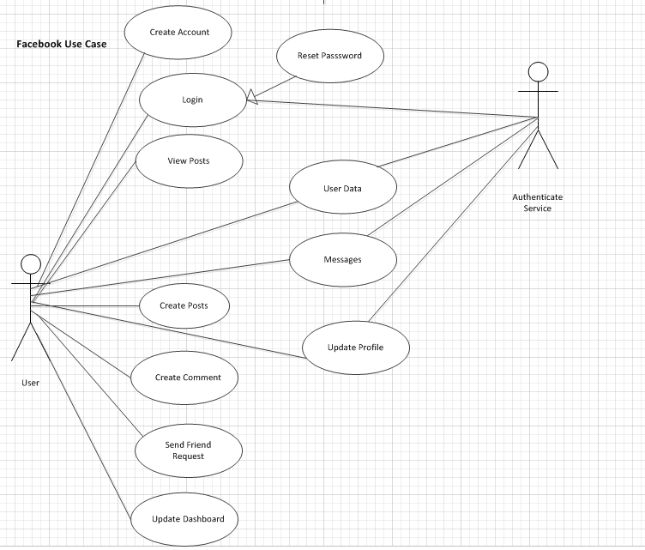
Diagram Use Case

Slide 14
Use Case - User
Main Scenario - User
Alternate Scenario
Login failed
User is shown an error message.
Create Account.
Login.
View Post.
Reset Password (upon successful login).
Preconditions
Post-Condition
Authenticated: False (user is not yet authenticated)
Registered: True (user id is registered)
Authenticated: True (authenticate service was able to verify user id and password entered)

Slide 15
Use Case – Logged in User
Main Scenario - User
Alternate Scenario
Login failed
User is shown an error message.
User Data.
Messages.
Update Profile.
Preconditions
Post-Condition
Authenticated: True(user is authenticated)
Registered: True (user id is registered)
User is notified of successful user data request/ message/ or profile update.

Slide 16
Use Case – Logged in User
Main Scenario - User
Alternate Scenario
System inaccessible
User is shown an error message.
Create Posts
Create Comment
Send friend request
Update dashboard
Preconditions
Post-Condition
Registered: True (user id is registered)
Authenticated: True (user is authenticated)
User is notified of successful posts/ comment/ request sent/ or update dashboard.

Slide 17
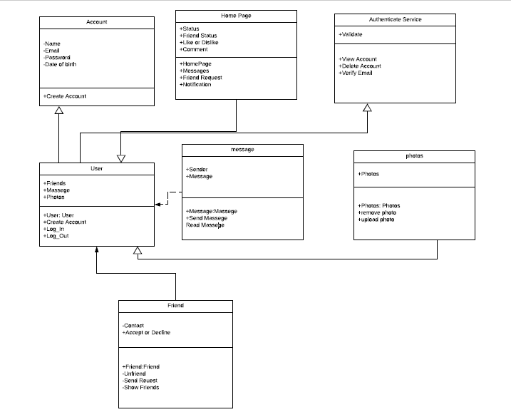
Class Diagram

Slide 18
Class Diagram
Class Diagram captures association between User, Home Page, Account, Authenticate Service, Messages, Photos, and Friend Class. Directed Association is utilized to indicate flow of the association.
User & Account
User & Home Page
User and Account have Directed Association
Account Class stores User Information
The arrowhead indicates the container-contained relationship.
Account Class is container
User and Home Page have Directed Association
Here, Home Page stores User Information
The arrowhead indicates the container-contained relationship.
Home Page class is container

Slide 19
Class Diagram- Continued
User & Friend
User & Message
User and Friend have Directed Association
User Class stores Friend Information
The arrowhead indicates the container-contained relationship.
User Class is container
User and Message Class has realization relationship
In a realization relationship, one entity defines a set of functionalities.
Message Class defines Sender, Message, and message status like Send Message, and Read message.

Slide 20
Class Diagram - Continued
User & Authenticate Service
User & Photos
User and Authenticate Service have Directed Association
Authenticate Service Class stores User Information
The arrowhead indicates the container-contained relationship.
Authenticate Service Class is container
User and Photos have Directed Association
Here, User Class stores Photo Information
The arrowhead indicates the container-contained relationship.
User class is container

Slide 21
Thank You…

